Slide 1
Microsoft Encode Hackathon
Team BB – Fun311
Government Category

Slide 2
Theme: Government 2
Canada’s growth has led to more living in cities. Urban modernization requires a more capable and improved infrastructure. A lot of these infrastructural elements, such as road surfaces, sidewalks, power lines and more need both urgent attention and continual maintenance—all while ensuring that all residents are served inclusively and safely. Building a feedback loop for citizen engagement and trust between governments and citizens.
Challenge: Create something that can use crowdsourced data to identify, categorize, and track problematic areas city services can then address. Note: Localization and accessibility are key to any solution designed to serve and engage with citizens. Consider using tools such as AI and machine learning (ML) in your creation. Consider, too, ways in which governments can capture user and technology metrics so as to generate reports leading to system improvements that better meet the needs of the community.
Objective: Simplify reporting of problematic city services and create feedback loop for citizen engagement.

Slide 3
Gathering Domain Knowledge
To understand how to improve the community, we called those who understand the problem best – Toronto 311.
We asked: What gets most reported by the community, and what would be useful to them?

Slide 4
What 311 hears from the public.
Noise complaints
Animal services
Unsanitary conditions
Water infrastructure complaints (broken mains, sewer blocked, water shutoff)
Bad roads, potholes
People disregarding social distancing
We found this to be consistent with common complaints to the city on twitter, reddit, and other platforms.

Slide 5
Bringing order from chaos
1. Gathering feedback from data sources
2. Process data
3. Generate location-based reports
4. Create and send Alerts

Slide 6
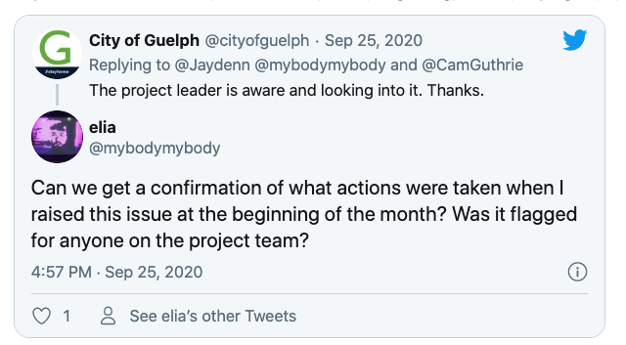
No feedback loop for citizen engagement

Slide 7
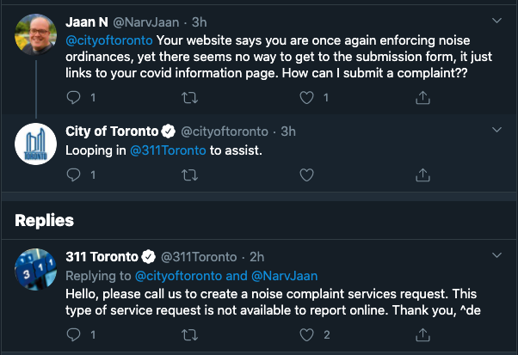
No accessibility – could benefit from AI & automation

Slide 8
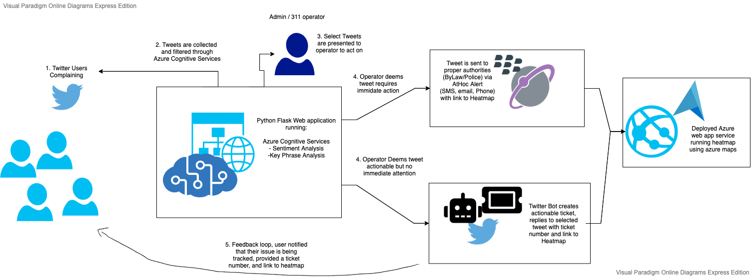
Architecture

Slide 9

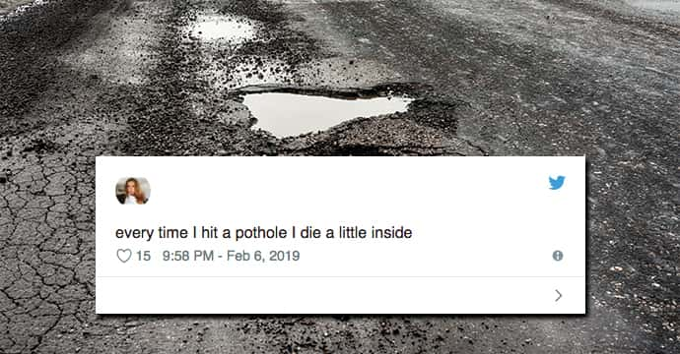
Demo
twitter
A Custom reporting app
reddit
Data set
Where do people go to complain about things in their community?
We could build a custom app to gather community complaints, but we already have that in twitter, reddit, etc.

Slide 10

2. Processing Data
Select a location, town, or city
People generally @ the city account when they have an issue
Mentions of a given Entity
Process tweet text with
Azure sentiment analysis
Context analysis
Image analysis for tweets with images

Slide 11

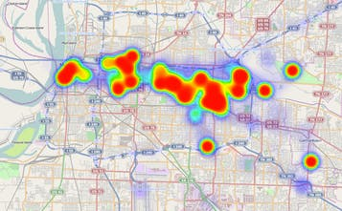
3. Generate a Report
Location based negative feedback can be fed into a report that is categorized
Time series insights will provide guided feedback on where problematic areas in the city need to be addressed

Slide 12
Summary
Based on categorization of tweets, send athoc alert to associated municipality services
Ex. Noise complaints -> police
Alert citizens with tweet, text, and heatmap of issue to improve civic engagement
Github: https://github.com/JeffinWithYa/MicrosoftEncodeHackathon2020

